Slide 1
Solutions designed by:
Daniel Rozario
Md. Abdullah Al Mahfuz
Md Abu Raihan
Bornita Ghosh
Rafiul Islam Rafi
Atia Sanjida Saba

Slide 2
Problem Solving

Slide 3
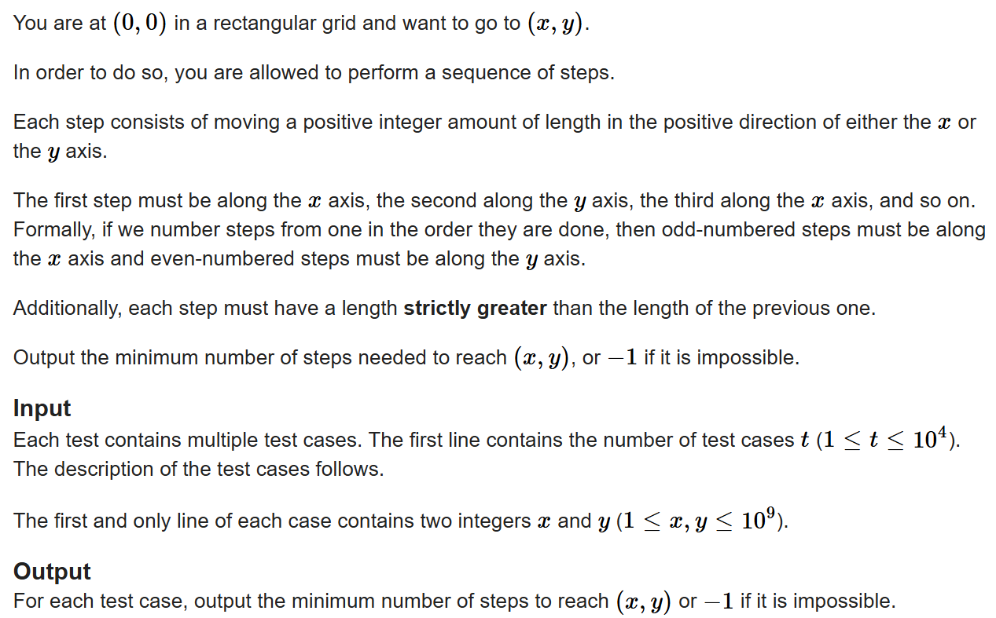
Problem-05: Shortest Increasing Path
(Problem Source: https://codeforces.com/problemset/problem/2147/A )

Slide 4
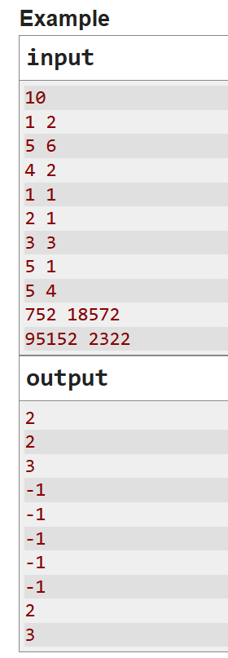

Slide 5
The Solution

Slide 6
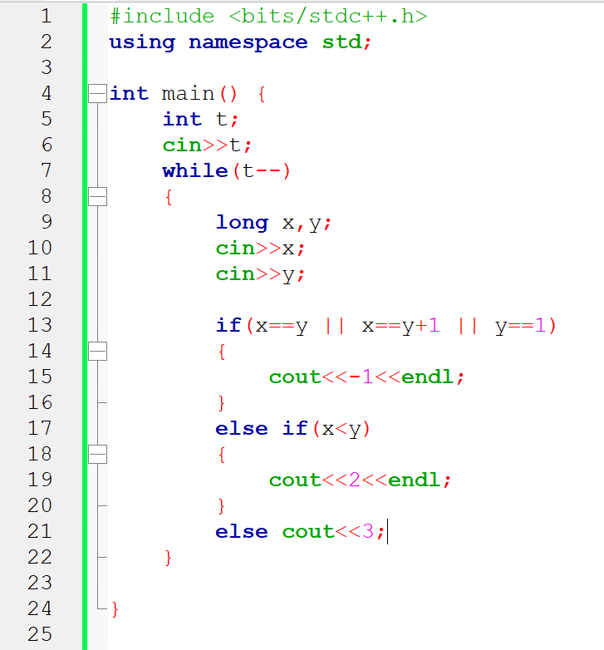

Slide 7
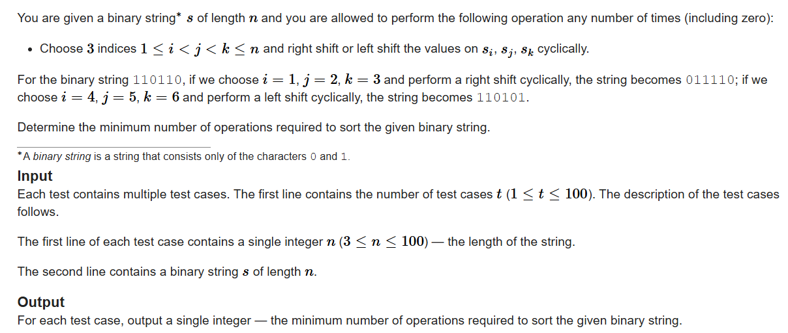
Problem-06: Shift Sort
(Problem Source: https://codeforces.com/problemset/problem/2140/A )

Slide 8
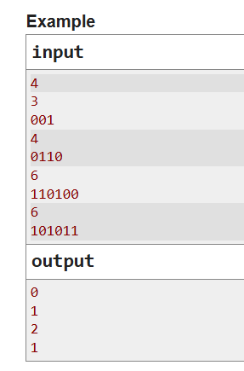

Slide 9
The Solution

Slide 10
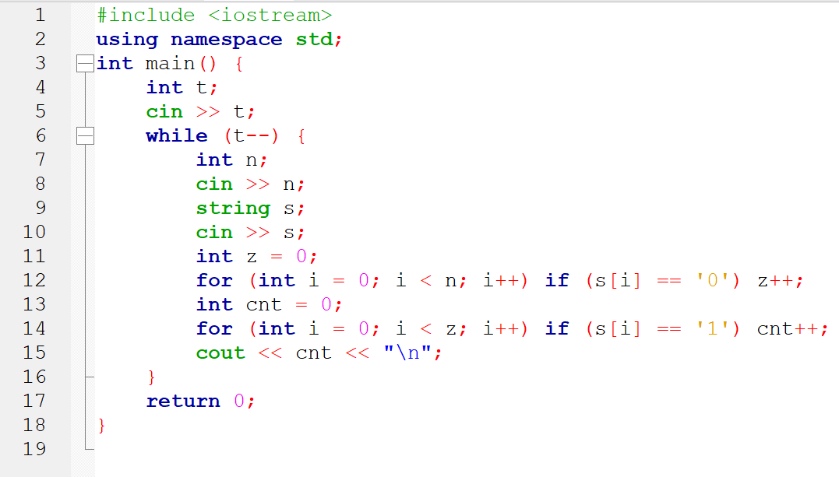

Slide 11
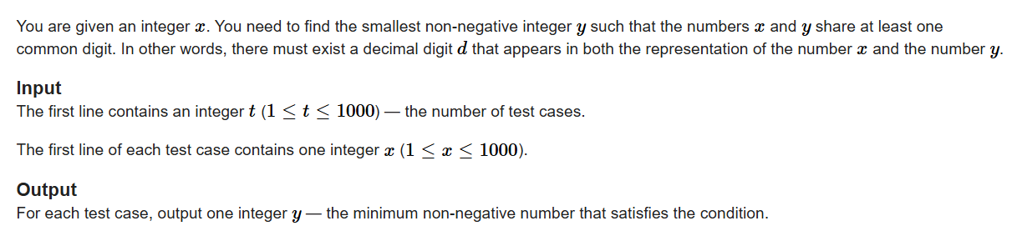
Problem-07: Only One Digit
(Problem Source: https://codeforces.com/problemset/problem/2126/A )

Slide 12
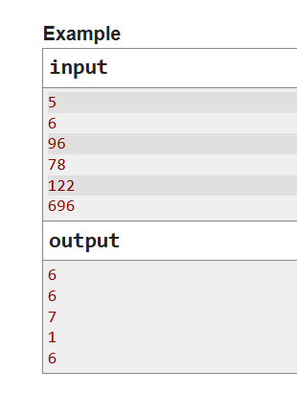

Slide 13
The Solution

Slide 14
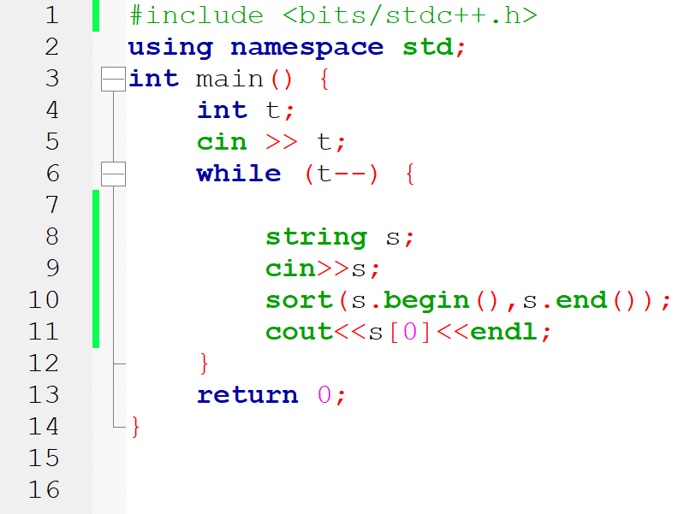

Slide 15
Problem-08
You are given an array of characters, and each character can only be one of theses: 'b', ‘o', or 'd’.
Suppose, a word "bod" is written on a mirror. When looking at the other side of the mirror, the characters appear reversed and each character becomes its mirrored version.
Given the input array (which always contains any or all from the characters ‘b’, ’o’ or ‘d’), determine what the string looks like from the other side of the mirror.
Example:
Input | Output
Test Case: 4
bod | bod
bdoo | oobd
obbbo | odddo
dddddbb | ddbbbbb

Slide 16
The Solution

Slide 17
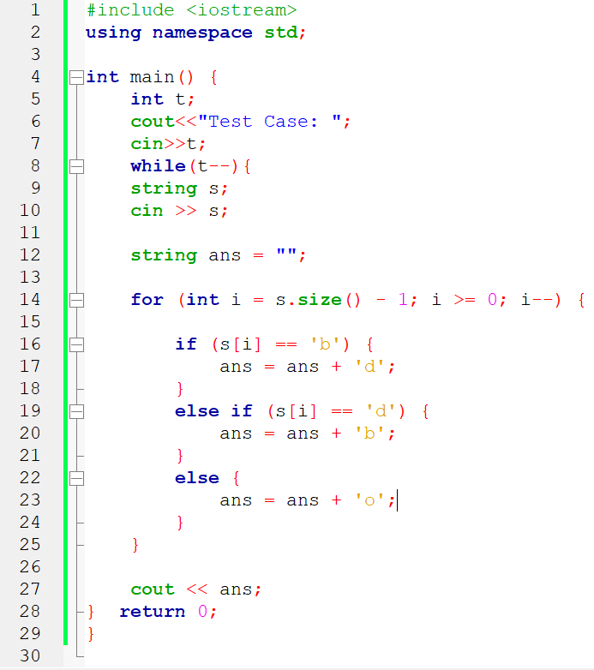

Slide 18
Problem-09
You are given an array of n integers.
You will also be given an integer target.
Your task is to check whether any two elements in the array add up to the target value.
If such a pair exists → print 1
Otherwise → print 0
Example:
Input | Output
Test Case: 3
Array Size: 5 Array Elements: 2 7 4 1 8 Target: 9 | 1
Array Size: 4 Array Elements: 1 2 3 4 Target: 8 | 0
Array Size: 5 Array Elements: 0 -1 2 -3 1 Target: -2 | 1

Slide 19
The Solution

Slide 20
